Slide 1
RED ROOSTER
WEB TECHNOLOGIES PROJECT

Slide 2
GROUP MEMBERS
MUHAMMAD TAHA – F2018065102
MUBARRA AZAM – F2018065015
ESHA MUNIR – F2018065044

Slide 3
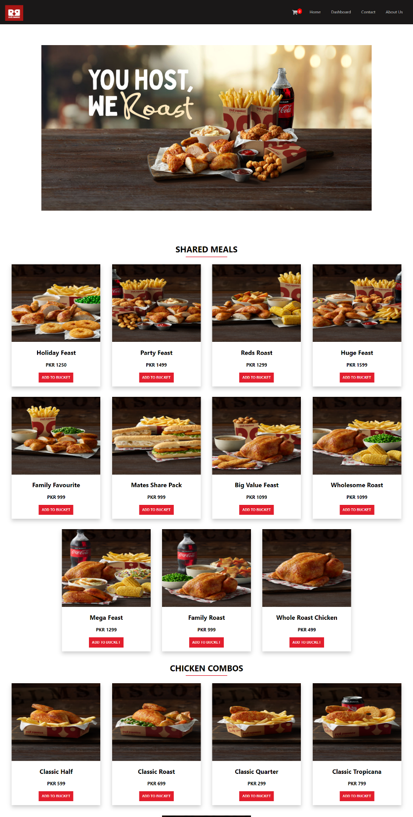

Slide 4
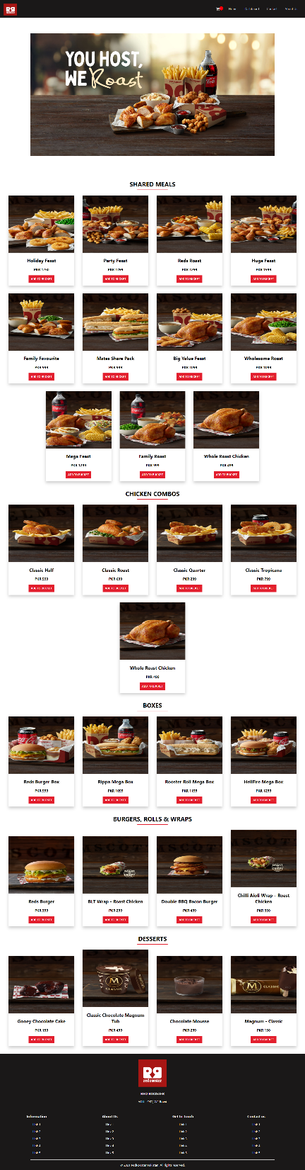

Slide 5
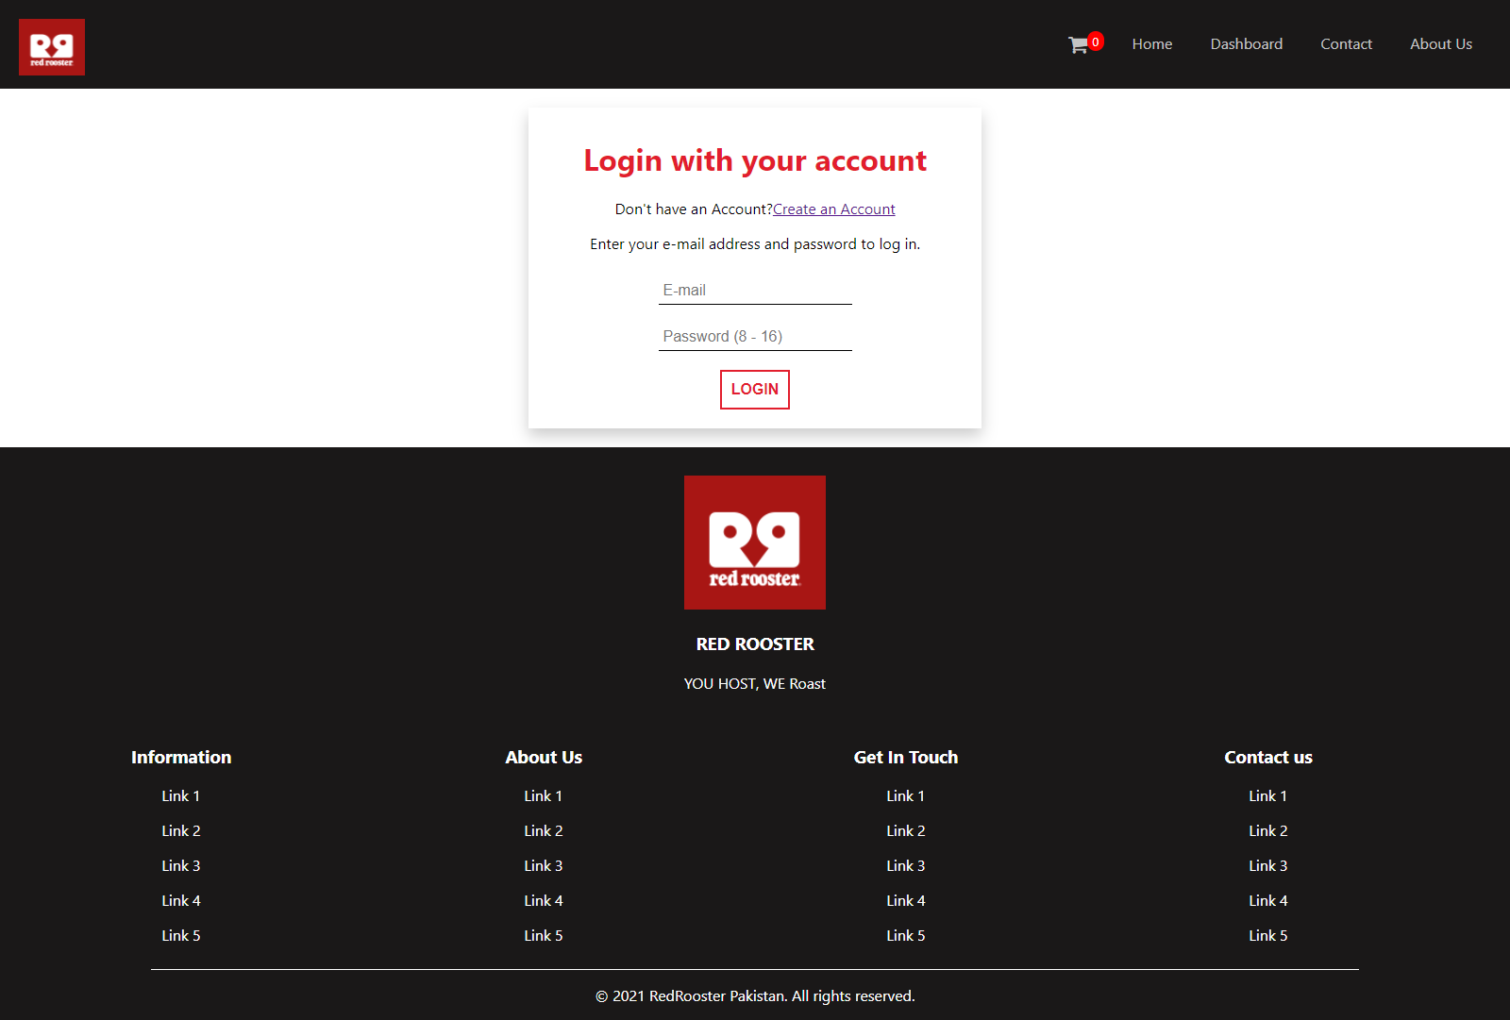

Slide 6
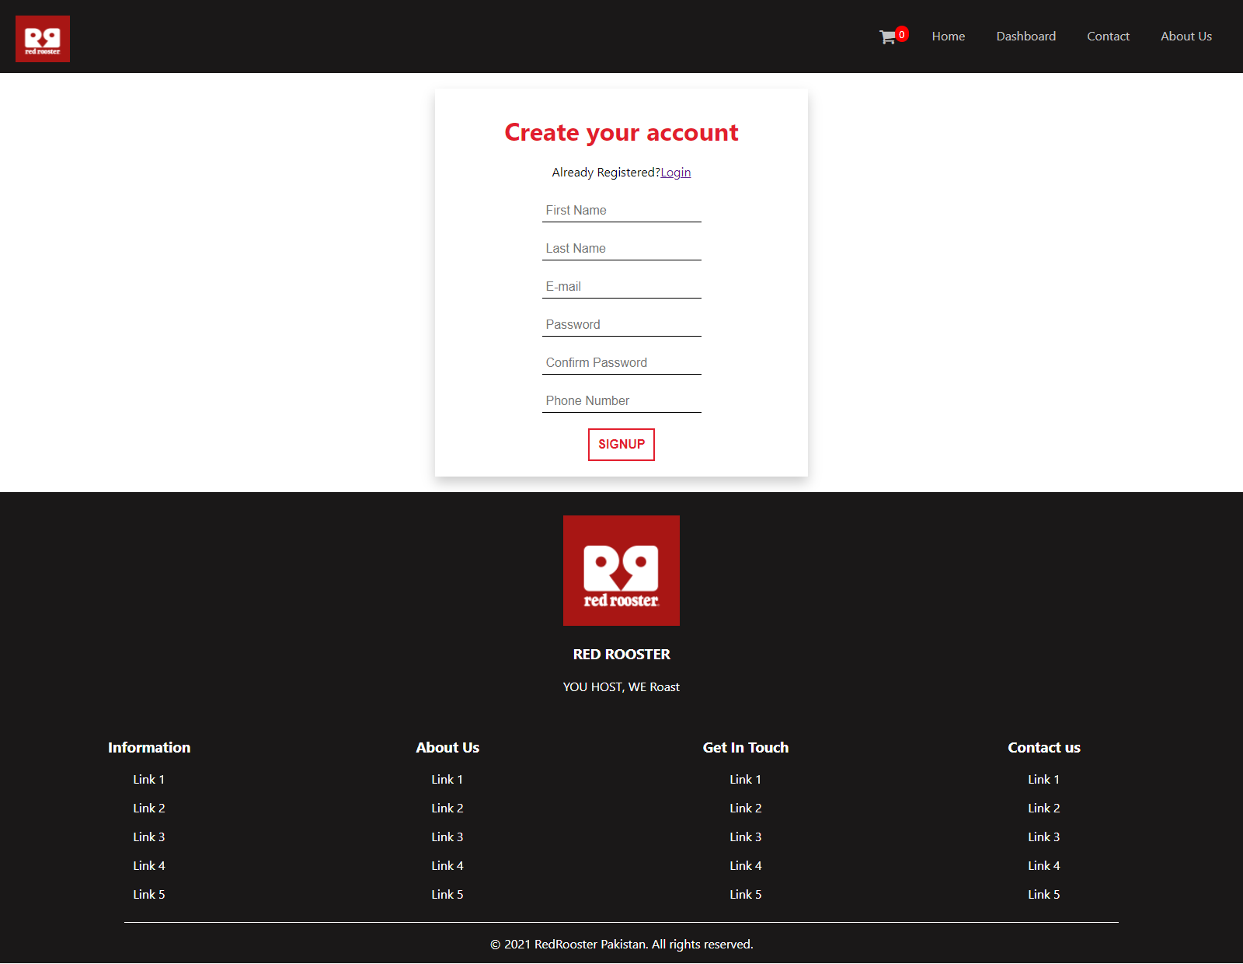

Slide 7
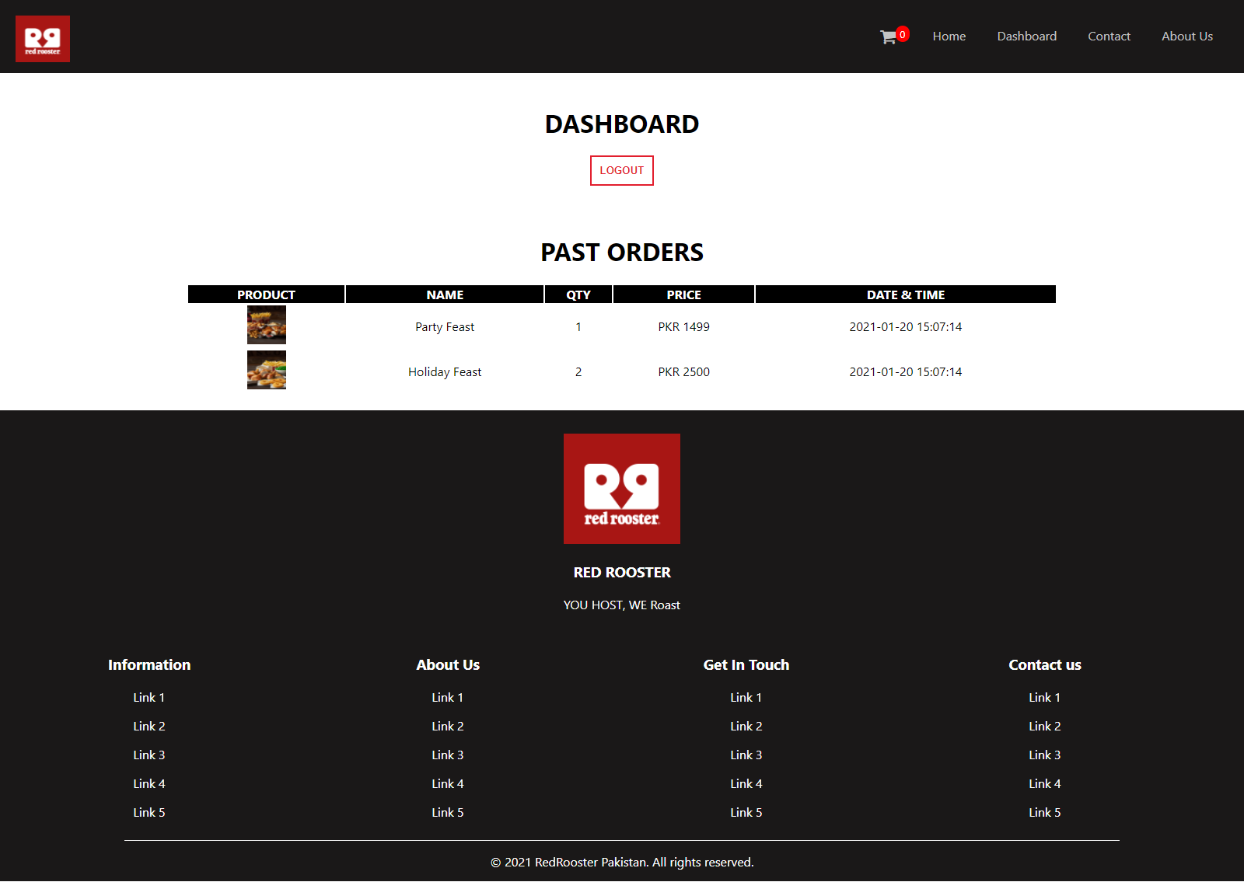

Slide 8
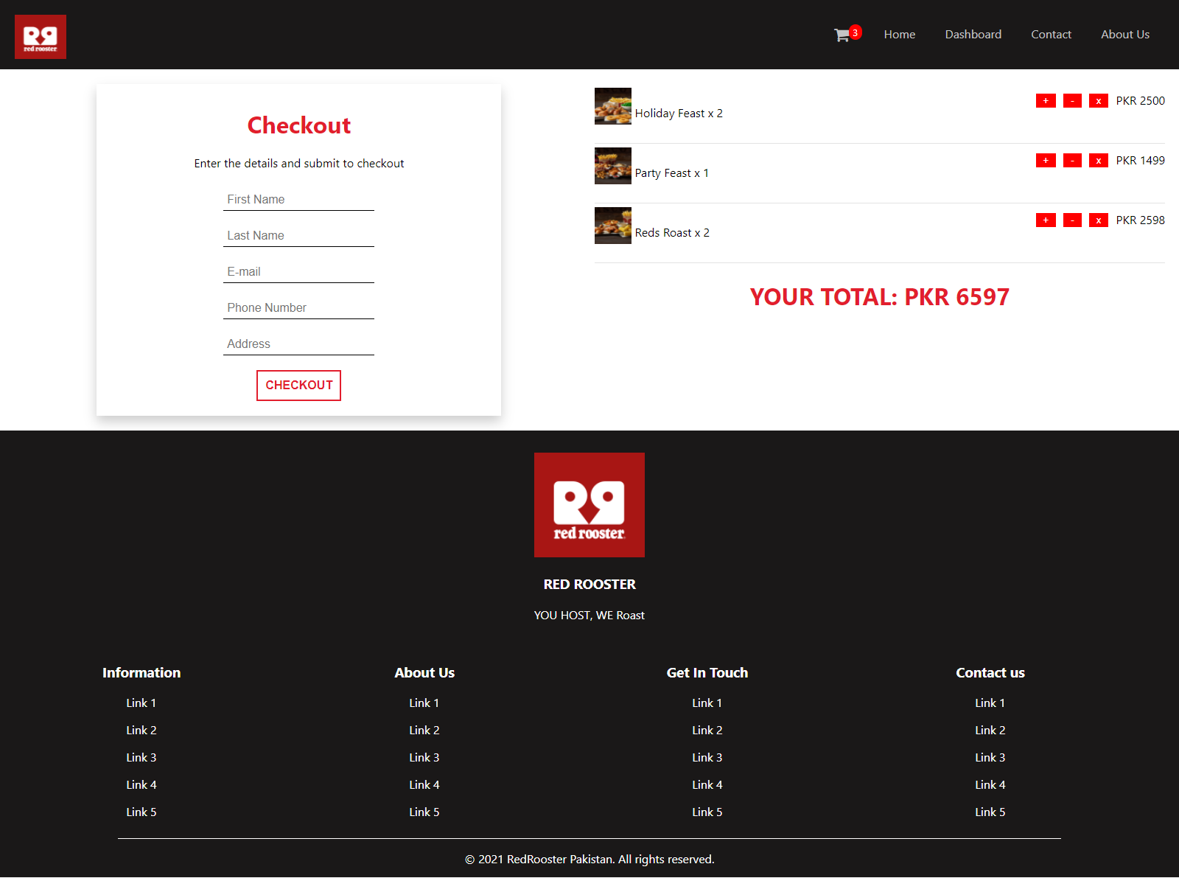

Slide 9
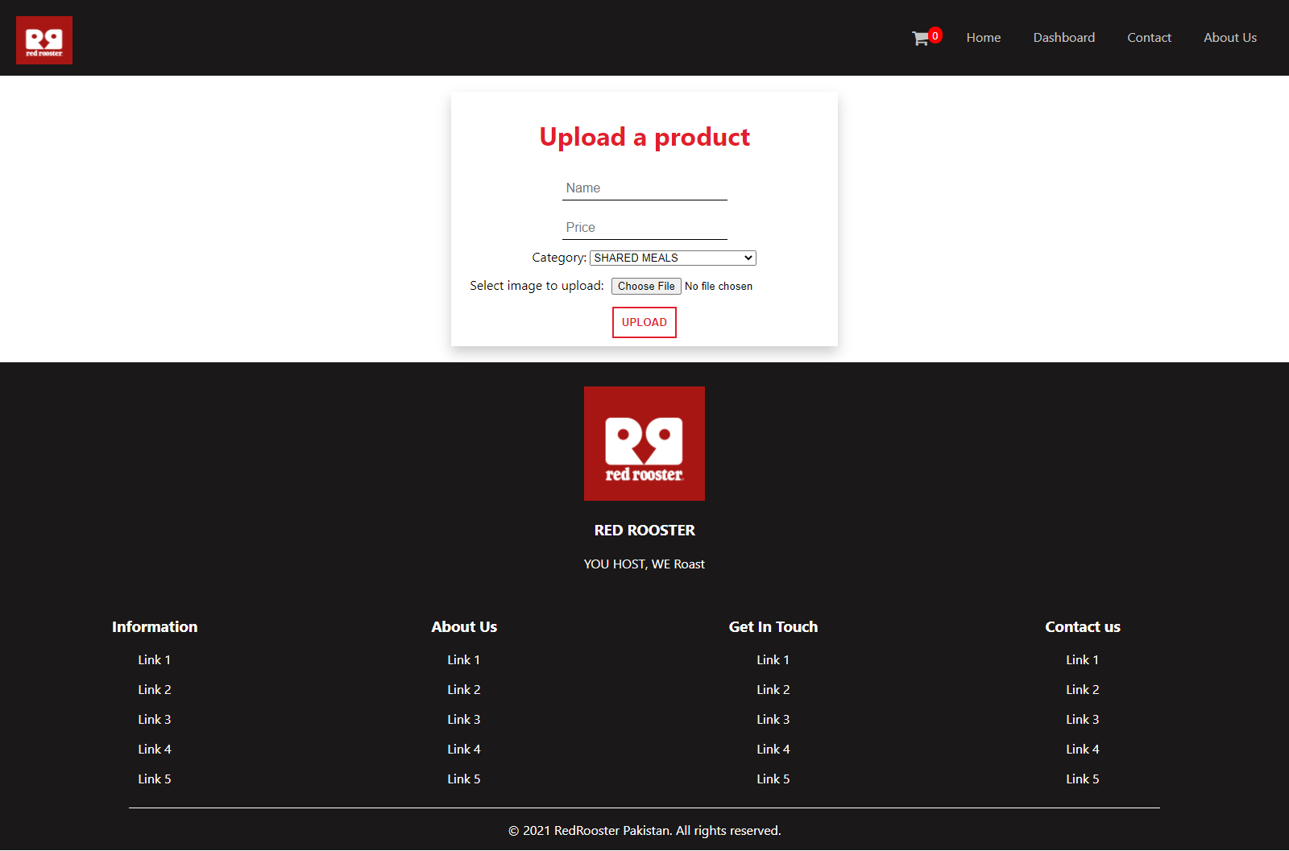

Slide 10
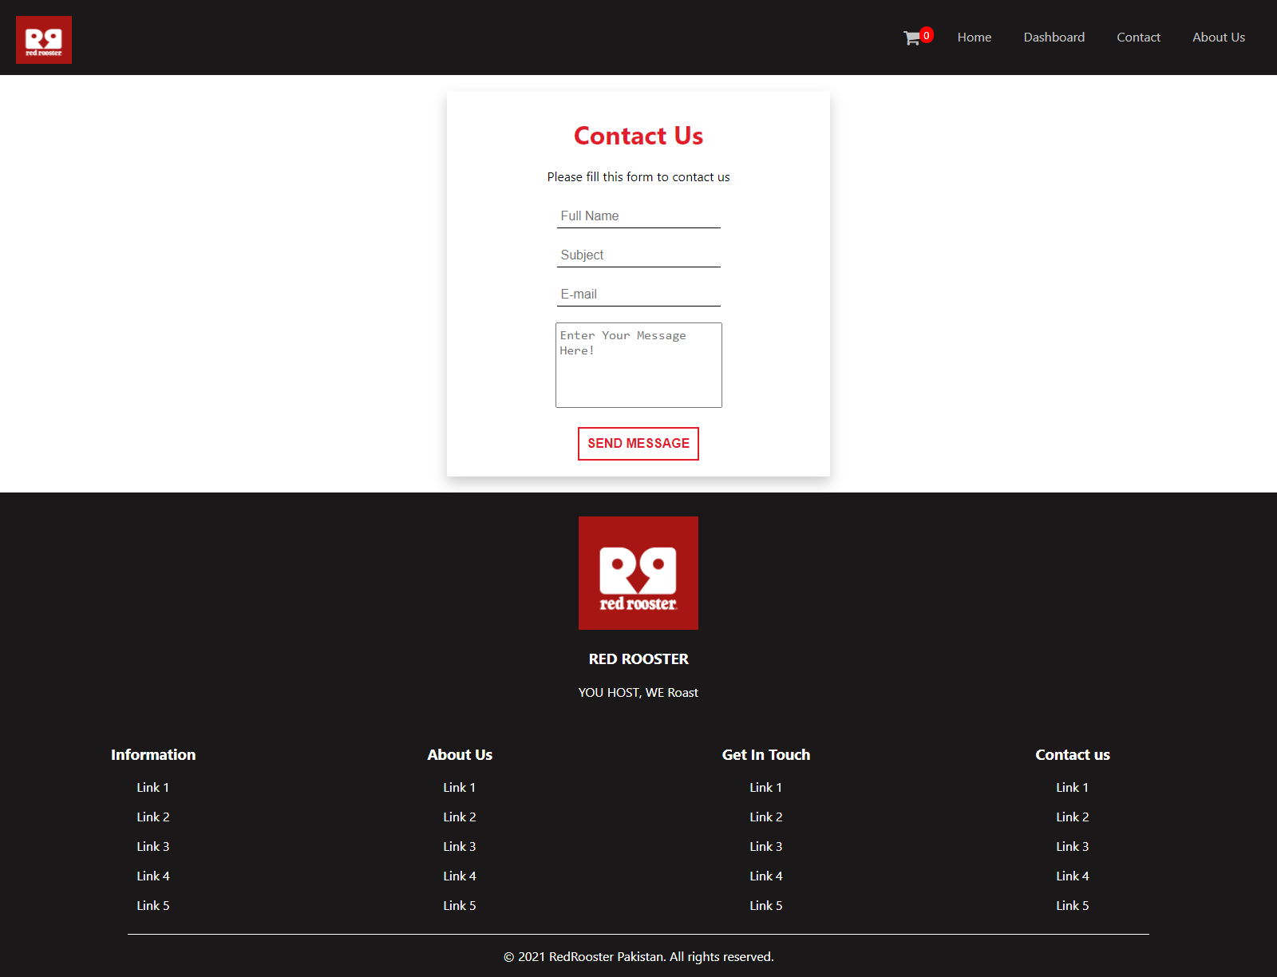

Slide 11
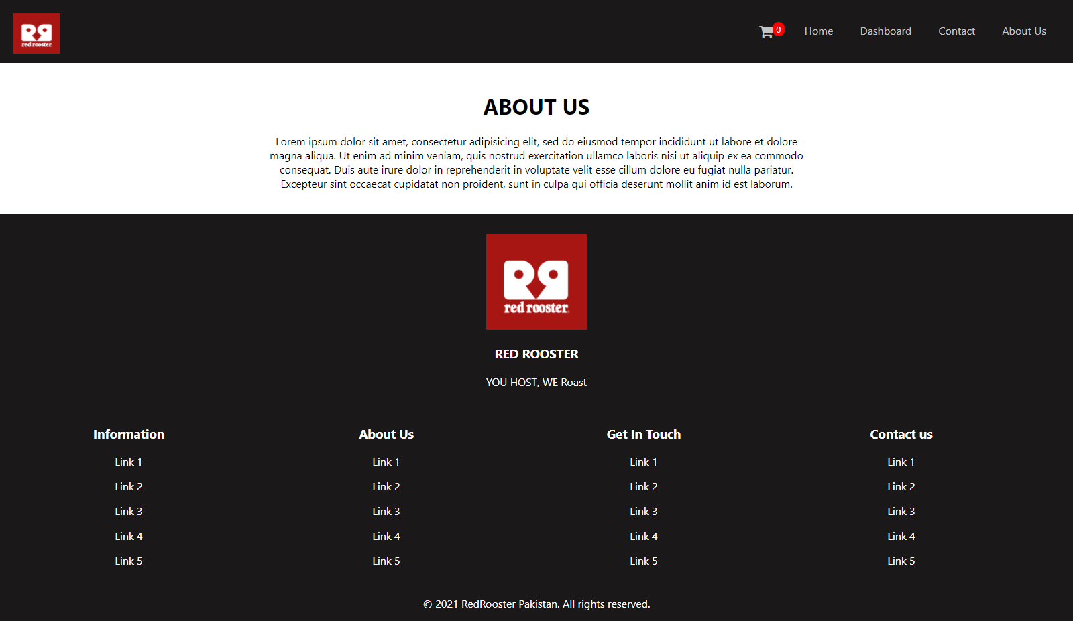

Slide 12
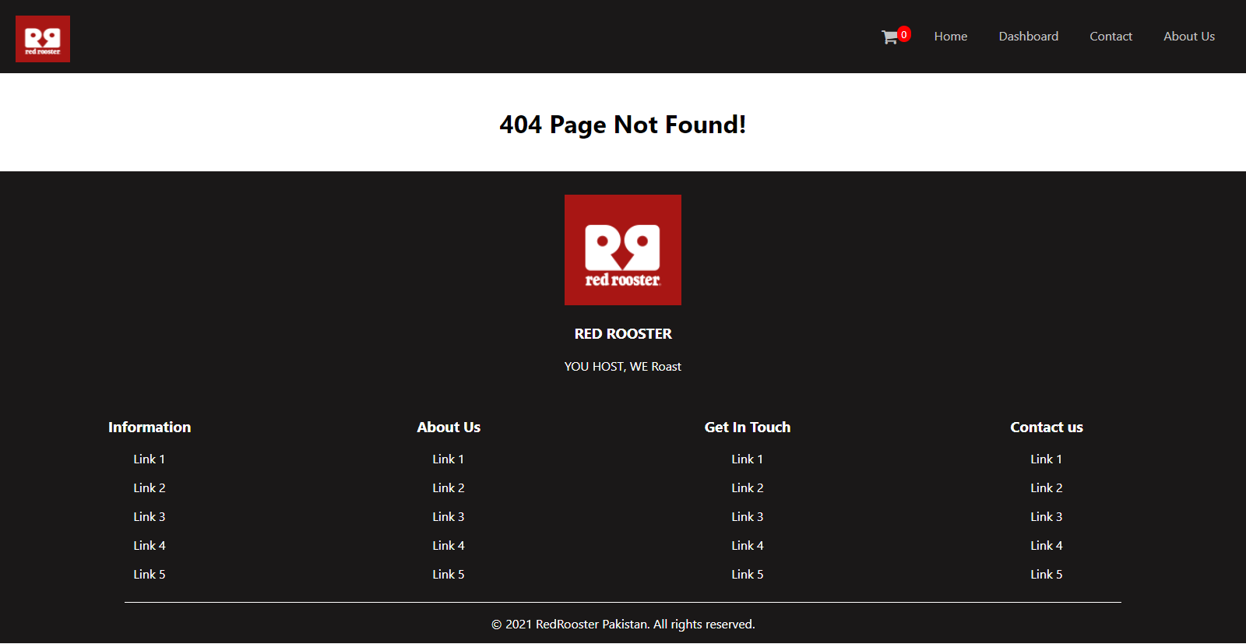

Slide 13
THANK YOU

